Slide 1



GPU Programming with CUDA
引言
王桢
wangzh665@mail.sysu.edu.cn
中山大学 计算机学院
国家超级计算广州中心

Slide 2
课程主要内容
相关知识背景补充（3-4课时）
CUDA与GPGPU、C/CPP语言基础
CUDA与并行计算基础（12-16课时）
GPU架构、CUDA线程、内存结构、通信同步机制、性能优化
其他并行编程框架（CUDA+MPI，GPGPU与CUDA的关系）
CUDA应用举例（剩余）
矩阵乘法，排序，图像高斯模糊，Ray Tracing, 等
CUDA库选择介绍
Thrust, cuDNN, cuBLAS, 等

Slide 3
参考书目（文档）
E. Kandrot and J. Sanders, CUDA by Example: An Introduction to General-Purpose GPU Programming, Pearson, 2010.
中译版：GPU高性能编程：CUDA实战
N. Wilt, The CUDA Handbook: A Comprehensive Guide to GPU Programming, Prentice Hall, 2013.
中译版：CUDA专家手册：GPU编程权威指南
J. Cheng, M. Grossman, and T. McKercher, Professional CUDA C Programming, Wrox, 2014.
中译版：CUDA C编程权威指南
NVIDIA官方文档：
CUDA C Programming Guide
CUDA C Programming Best Practice Guide

Slide 4
本次课程概要
History of GPU
Why GPU (CUDA)？
GPU (CUDA) 加速效果
安装与项目创建

Slide 5
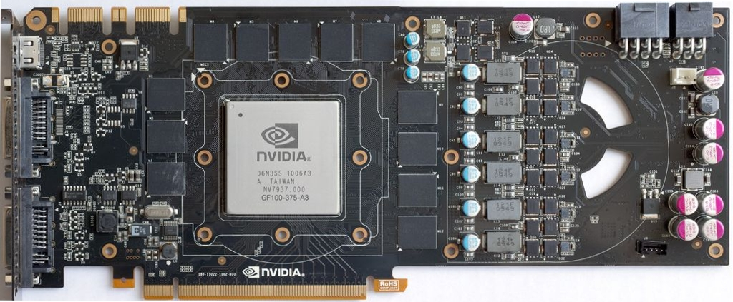
History of GPUs …
How did they evolve?

Slide 6
Why Looking at GPU History?
Looking at how things evolved can highlight future directions.
Some of the current architecture decisions won’t make sense without historical perspective.

Slide 7
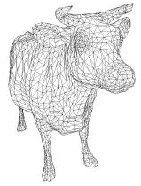
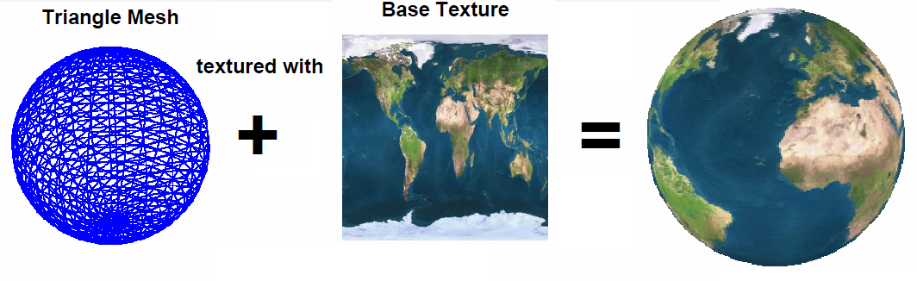
Graphic Elements
Vertex: A point with 3D coordinate and color.
Polygons: composed of vertices and edges.
Mesh: A grid of polygons to represent an object.
Objects: Any 2D or 3D entity whose shape could be represented by mesh of arbitrary polygons.
Primitive: Classical geometric shapes can be directly used as primitives (e.g. point, line, cube, cylinder, sphere...) to make parts of objects.
F. Durand, “A Short Introduction to Computer Graphics”, MIT Laboratory for Computer Science
R. Fernando, C. Zeller, “Programming Graphics Hardware Programming Hardware”, NVIDIA.
Notes:
A caw modeled as a mesh of triangles.

Slide 8
Graphic Elements
Texture: An image that is mapped on the surface of polygons on objects to provide a concept of specific material.
Color: The color of each pixel is described by three numbers for intensity of main colors: red, green, and blue, e.g. (255, 0, 255).
Pixel: A computer image is represented by an array of points called pixel with its own color and coordinate (address).
Resolution: The number of pixels in an image determines the resolution of the image, e.g. 320x200, 2560x2048.
Fragment: All necessary data needed to generate a single pixel of final image in output memory, e.g. coordinates, color, depth...
F. Durand, “A Short Introduction to Computer Graphics”, MIT Laboratory for Computer Science
R. Fernando, C. Zeller, “Programming Graphics Hardware Programming Hardware”, NVIDIA.
Notes:
A caw modeled as a mesh of triangles.

Slide 9
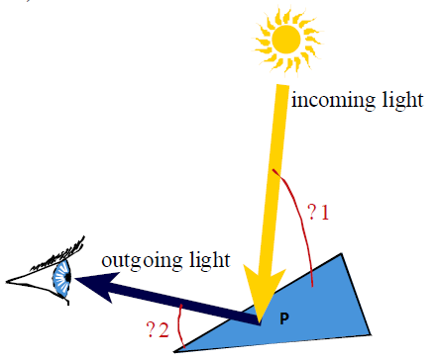
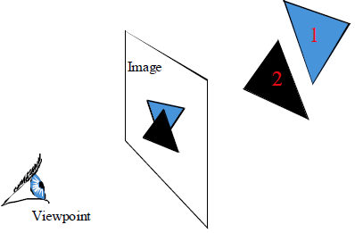
Graphic Pipeline
Several mathematical computation stages to realize 3D virtual scenes into 2D images.
Geometry-Stage:
lighting properties of all vertices should be found by considering a light source and a viewer at desired point and their angle.
Lighting Process
Rasterization(光栅化)-Stage:
Drawing covered pixels by the primitives (line or triangle) is called rasterization.
F. Durand, “A Short Introduction to Computer Graphics”, MIT Laboratory for Computer Science
Notes:
One of the most important reasons of improving graphic cards was to realize 3D virtual scenes into 2D images. Rendering an image is performed by doing various processes on four basic elements: vertices, primitives, fragments, and pixels. This could be done by passing data through several mathematical computation stages called Graphics Pipeline.
All objects in a 3D scene should be transformed to unique system with their own coordinations. Transformations are done by multiplication with translation, rotation and scaling matrices.
Next, lighting properties of all vertices should be found by considering a light source and a viewer at desired point and their angle.
Drawing covered pixels by the primitives (line or triangle) is called rasterization. Each primitive generates a set of fragments, which all of its properties, including color, texture, depth and visibility, should be calculated in this stage.

Slide 10
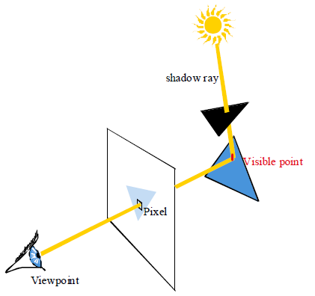
Graphic Pipeline
Shading-Stage:
Objects should be shaded according to their interaction with light sources.
R. Fernando, C. Zeller, “Programming Graphics Hardware Programming Hardware”, NVIDIA.
Notes:
Enhancing the scene with multiple light sources and reflections allows for better rendering. So, the objects should be shaded according to their interaction with light sources. As a result, two other stages, vertex shading and pixel shading, were added in 2001. There are various methods of shading.
A shadow ray is considered from the light source to the visible point of the object, if the ray passes the surface then the point is in shadow. In this method, shadow calculations must be performed for all pixels and each light source separately.
the term "vertex shader" is indeed a misnomer. The term "shader" is used for any program that typically runs on the GPU (as opposed to the CPU). The first incarnation of these were pixel shaders, also known as fragment shaders, where the name still made sense.
Then vertex shaders were invented, but they don't actually shade anything; they have the ability to transform a vertex's position in space, and they can pass down per-vertex data to the pixel shader. "Vertex program" would be a better name, but the word "shader" apparently stuck.

Slide 11
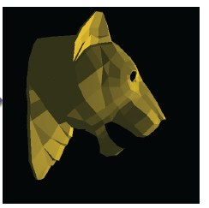
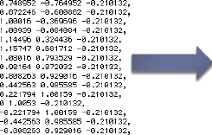
From Numbers to Screen

Slide 12
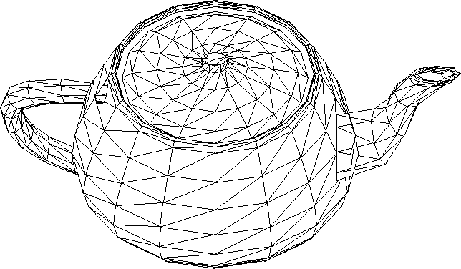
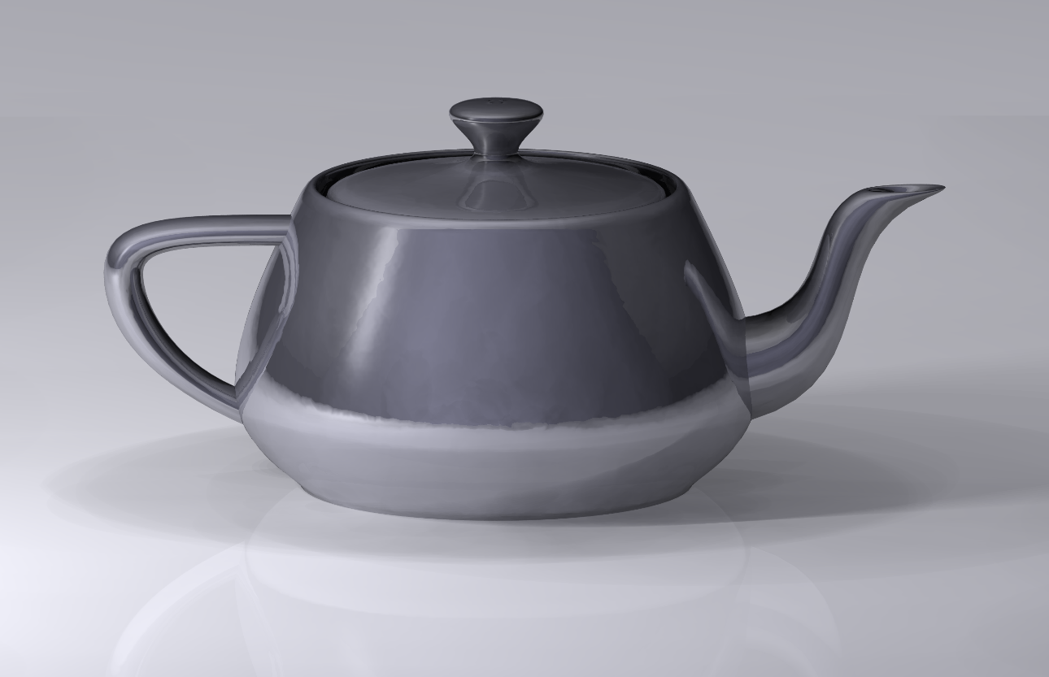
Render triangles.
NVIDIA GTX480 can render 1.6 billion triangles per second!

Slide 13
Before GPUs
Vertices to pixels:
Transformations done on CPU
Compute each pixel “by hand”, in series… slow!
Example:
1 million triangles * 100 pixels per triangle *
10 lights * 4 cycles per light computation =
4 billion cycles

Slide 14
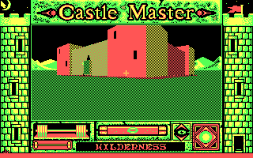
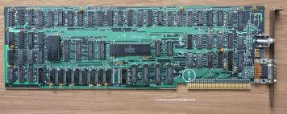
Early GPUs: Early 80s to Late 90s
Color Graphic Adapter (CGA 1981)
4 bit RGBI
40 x 25 Characters
320 x 200 Pixel, 16 Colors
640 x 200 Pixel Maximum
16 Kilo Byte Memory
Notes:
RGBI: Red, Green, Blue, Intensity

Slide 15
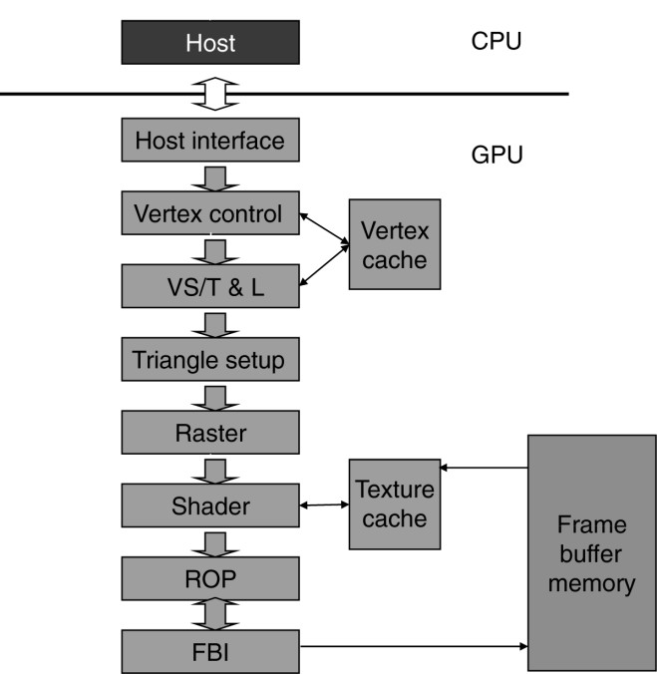
Early GPUs: Early 80s to Late 90s
Fixed-Function Pipeline

Slide 16
Early GPUs: Early 80s to Late 90s
Fixed-Function Pipeline
Receives graphics commands and data from CPU

Slide 17
Early GPUs: Early 80s to Late 90s
Fixed-Function Pipeline
Receives triangle data
Converts them into a form that hardware understands
Store the prepared data in vertex cache

Slide 18
Early GPUs: Early 80s to Late 90s
Fixed-Function Pipeline
Vertex shading transform and lighting
Assigns per-vertex value (colors, …).

Slide 19
Early GPUs: Early 80s to Late 90s
Fixed-Function Pipeline
Creates edge equations to interpolate colors across pixels touched by the triangle

Slide 20
Early GPUs: Early 80s to Late 90s
Fixed-Function Pipeline
Determines which pixel falls into which triangle
For each pixel, interpolate per-pixel values from vertices

Slide 21
Early GPUs: Early 80s to Late 90s
Fixed-Function Pipeline
Determines the final color of each pixel

Slide 22
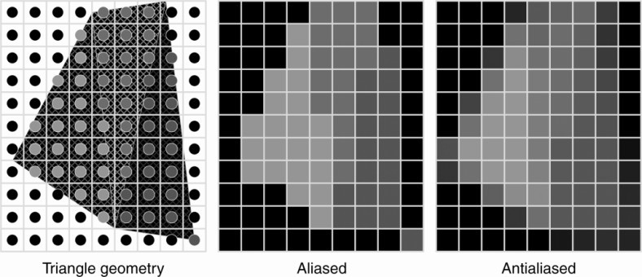
Early GPUs: Early 80s to Late 90s
Fixed-Function Pipeline
The raster operation:
performs color raster operations that blend the color of overlapping objects for transparency and antialiasing
Notes:
antialiasing
[词典]【计】消除混叠现象，消除走样，图形保真
Anti－aliasing （抗锯齿处理）
简单地说主要是应用调色技术将图形边缘的“锯齿”缓和，边缘更平滑。抗锯齿是相对来来说较复杂的技术，一直是高档加速卡的一个主要特征。目前的低档3D加速卡大多不支持反锯齿。

Slide 23
Early GPUs: Early 80s to Late 90s
Fixed-Function Pipeline
The frame buffer interface
manages memory reads/writes.

Slide 24
Next Steps
In 2001:
NVIDIA exposed the application developer to the instruction set of VS/T&L stage
Later:
General programmability extended to shader stage → trend toward unifying the functionality of different stages as seen by application programmer.
In graphics pipelines, certain stages do a great deal of floating-points arithmetic on a completely independent data.
Data independence is exploited → key assumption in GPUs
Notes:
"VS/T&L stage" 是指"Vertex Shader/Transformation and Lighting stage"，即顶点着色器/变换与光照阶段。

Slide 25
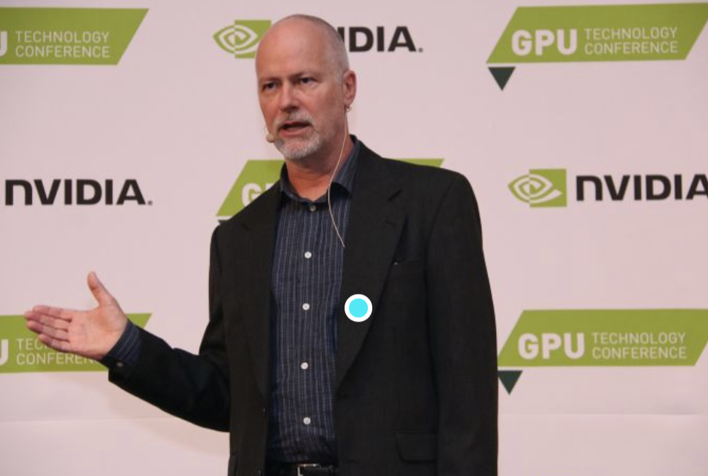
The Vision of NVIDIA
"Within the next few years, there will be single-chip graphics devices more powerful and versatile than any graphics system that has ever been built, at any price."
-- David Kirk, NVIDIA, 1998

Slide 26
In 2006
NVIDIA GeForce 8800 mapped separate graphics stage to a unified array of processors
For vertex shading, geometry processing, and pixel processing
Allows dynamic partition

Slide 27
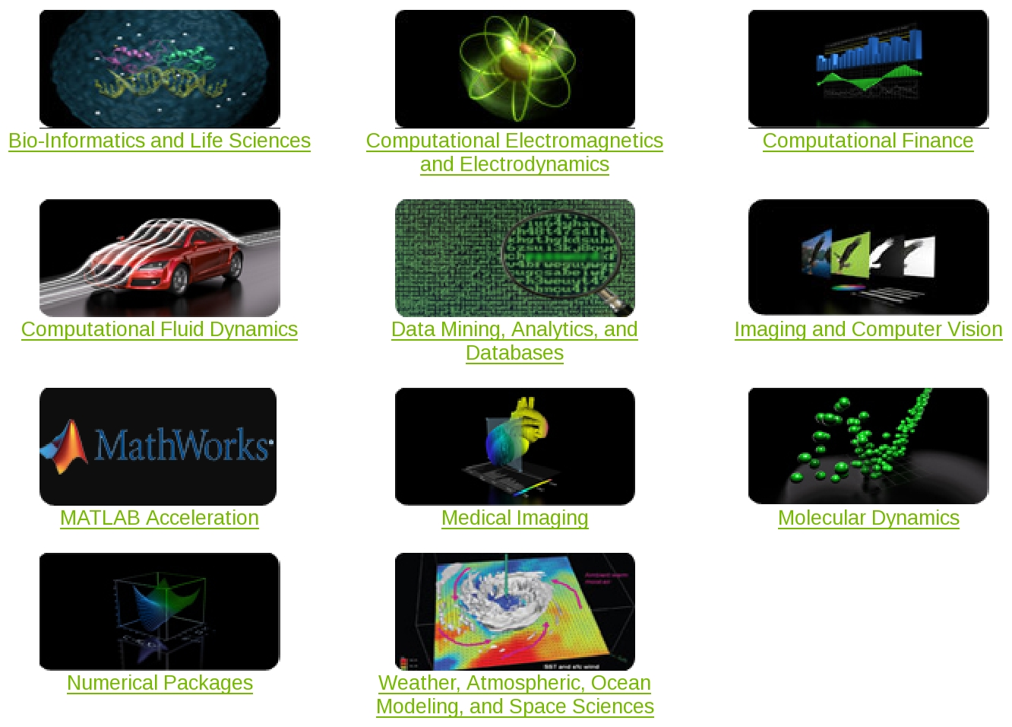
General Purposed GPU
ref: http://www.nvidia.com/object/tesla_computing_solutions.html
Notes:
GPU can achieve 10x performance over CPU.

Slide 28
Host
Input Assembler
Setup / Rstr / ZCull
Vtx Thread Issue
Geom Thread Issue
Pixel Thread Issue
SP
SP
SP
SP
SP
SP
SP
SP
SP
SP
SP
SP
SP
SP
SP
SP
Thread Processor
TF
TF
TF
TF
TF
TF
TF
TF
L1
L1
L1
L1
L1
L1
L1
L1
L2
L2
L2
L2
L2
L2
FB
FB
FB
FB
FB
FB
Exploring the use of GPUs to solve compute intensive problems The birth of GPGPU but there are many constraints
GPUs and associated APIs were designed to process graphics data

Slide 29

Previous GPGPU Constraints
Dealing with graphics API
Working with the corner cases of the graphics API
Addressing modes
Limited texture size/dimension
Shader capabilities
Limited outputs
Instruction sets
Lack of Integer & bit ops
Communication limited
No user-defined data types
per thread per Shader per Context
Input Registers
Fragment Program
Texture
Constants
Temp Registers
Output Registers
FB Memory

Slide 30
The Birth of GPU Computing
Step 1: Designing high-efficiency floating-point and
integer processors.
Step 2: Exploiting data parallelism by having large number of processors
Step 3: Shader processors fully programmable with large instruction cache, instruction memory, and instruction control logic.
Step 4: Reducing the cost of hardware by having multiple shader processors to share their cache and control logic.
Step 5: Adding memory load/store instructions with random byte addressing capability
Step 6: Developing CUDA C/C++ compiler, libraries, and runtime software models.

Slide 31
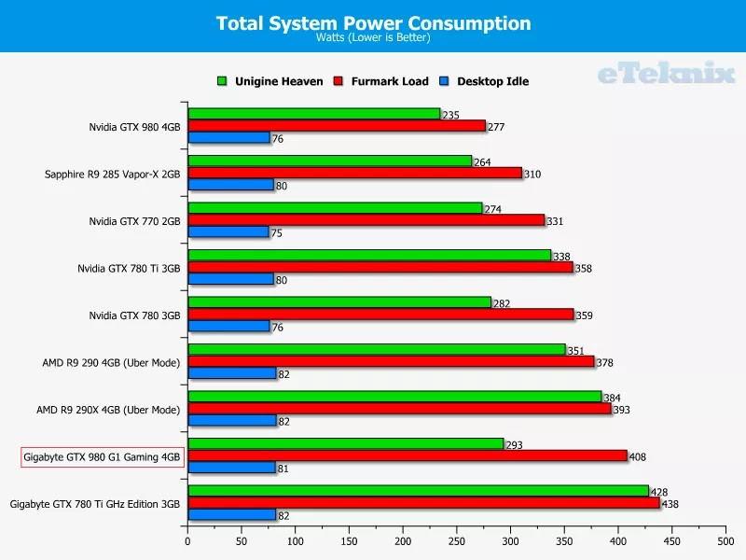
Problem With GPUs: Power
Source: http://www.eteknix.com/gigabyte-g1-gaming-geforce-gtx-980-4gb-graphics-card-review/17/

Slide 32
Problems Faced by GPUs
Need enough parallelism
Under-utilization
Bandwidth to CPU
Still a way to go

Slide 33
本次课程概要
History of GPU
Why GPU (CUDA)？
GPU (CUDA)加速效果
安装与项目创建

Slide 34
Why GPU (CUDA)?
摩尔定律
英特尔创始人之一戈登·摩尔提出：
”集成电路上可容纳的晶体管数目，
约每隔两年便会增长一倍“
另一版本为18个月（由英特尔首席执行官大卫·豪斯提出）

Slide 35
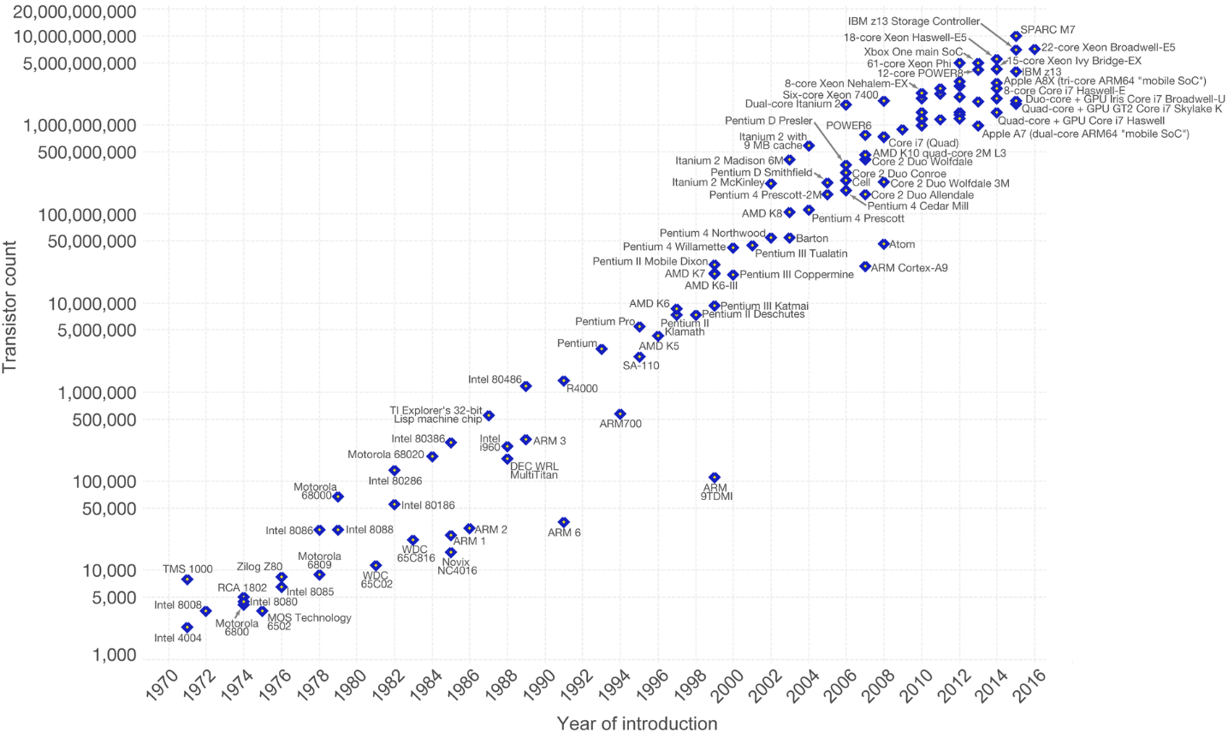
Why GPU (CUDA)?
摩尔定律
Licensed under CC-BY-SA by the author Max Roser.

Slide 36
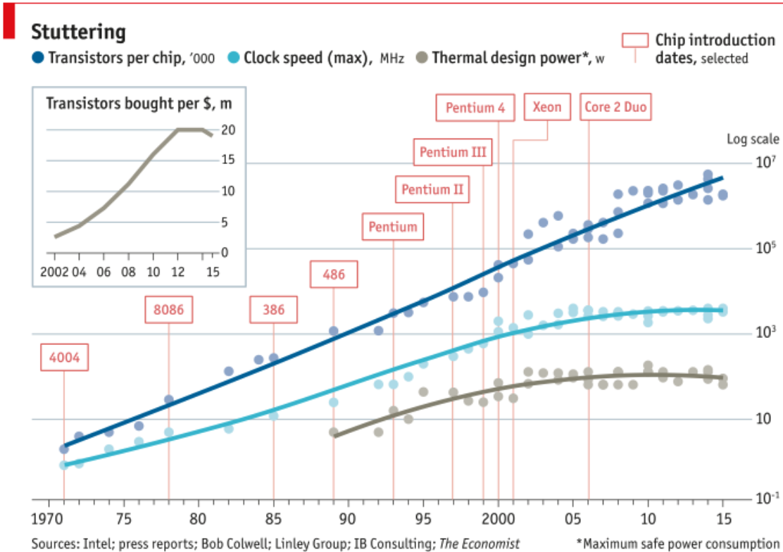
Why GPU (CUDA)?
摩尔定律的瓶颈
晶体管数目≠频率
摩尔定律还能持续多久？
2021/2025年假说
没有失效
制程仍在降低
但有减慢的趋势
量子穿隧效应
“The number of people predicting the death of Moore’s Law doubles every two years.”
-Peter Lee, Vice President, Microsoft Research
图片来源：The Economist’s Technology Quartlerly

Slide 37
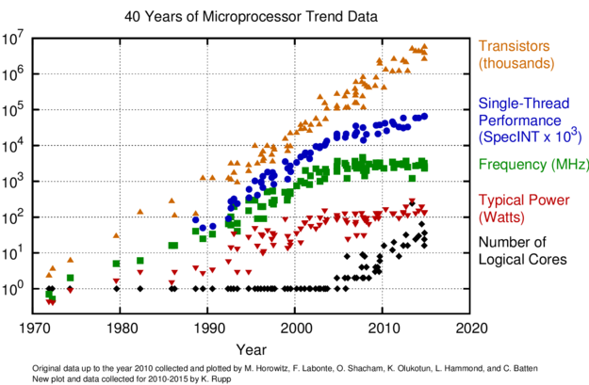
Why GPU (CUDA)?
摩尔定律的瓶颈
晶体管数目≠频率
摩尔定律还能持续多久？
2021/2025年假说
没有失效
制程仍在降低
但有减慢的趋势
量子穿隧效应
“The number of people predicting the death of Moore’s Law doubles every two years.”
-Peter Lee, Vice President, Microsoft Research
图片来源：Ars Technica

Slide 38
Why GPU (CUDA)?
串行速度提升已经结束
无法继续提升频率
难以继续降低功耗
当前计算机性能提升趋势
计算机没有变得更快，而是变得更宽
多核CPU、GPU、超级计算机
数据级别的并行
同样的指令作用于多个数据
线程级别的并行
图片来自网络

Slide 39
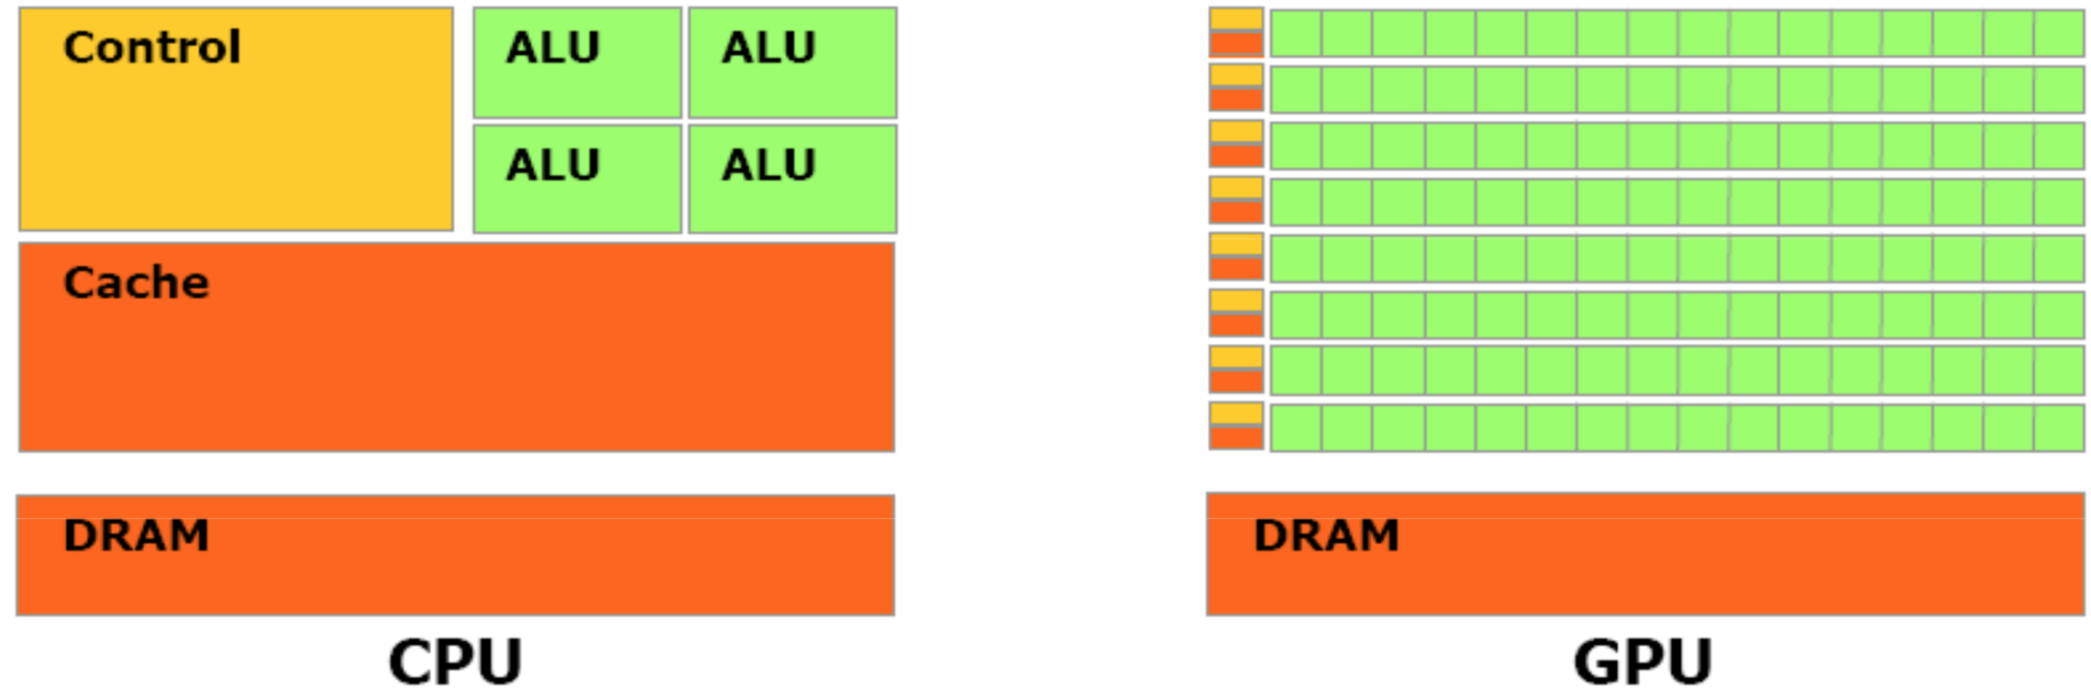
Why GPU (CUDA)?
GPGPU （General Purpose Computing for GPU)
GPU特征
高度并行化：同样指令应用于大量数据上
大量运算核心
图片来自NVIDIA

Slide 40
Why GPU (CUDA)?
GPGPU
图形绘制简易流程

Slide 41
Why GPU (CUDA)?
GPGPU基本思路
Vertex shader 和 fragment shader 可由用户自行通过shading language编程
把封装数据封装成图形绘制库所需的数据形式传入
绘制过程中通过修改shader执行用户编写的程序
通常是fragment shader
将结果绘制到texture中传出
需要很强的图形学编程能力

Slide 42
Why GPU (CUDA)？
CPU与GPU性能对比
图片来自NVIDIA
Notes:
2011-2012?

Slide 43
Why GPU (CUDA)？
GPU运算速度发展

Slide 44
Why GPU (CUDA)?
GPU与超级计算机

Slide 45
Why GPU (CUDA)?
CUDA vs OpenMP vs MPI
NVIDIA显卡
基于GPU线程并行

Slide 46
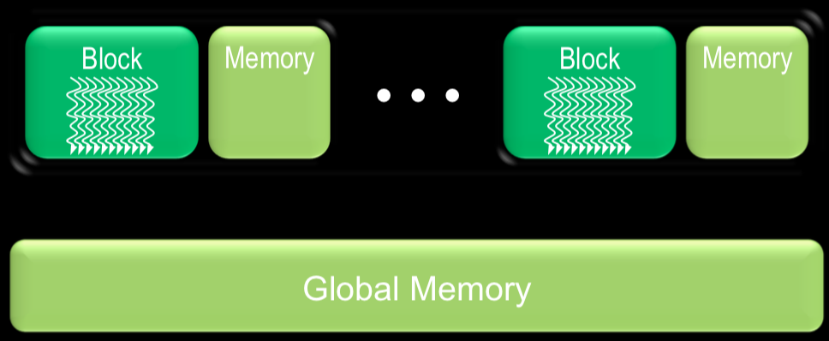
Why GPU (CUDA)?
CUDA vs OpenMP vs MPI
硬件结构
图中每条波浪线代表一个线程
每个block包含多个线程
只有block内部线程能访问其共享内存
所有线程均可访问全局存储器
图片来自NVIDIA

Slide 47
Why GPU (CUDA)?
CUDA vs OpenMP vs MPI
硬件结构
每个线程由一个CUDA core (a.k.a., streaming processor (SP)) 执行
Block中的线程以warp形式在streaming multiprocessor (SM)上执行
每个warp包含32个thread (typically)
warp中所有thread执行同样的指令 （Single Instruction Multiple Data）
图片来自NVIDIA
Notes:
A thread block (or just a block if the context makes it clear) is a collection of threads that run on a single streaming multiprocessor (SM).
A warp is a set of 32 threads within a thread block such that all the threads in a warp execute the same instruction. These threads are selected serially by the SM. Once a thread block is launched on a multiprocessor (SM), all of its warps are resident until their execution finishes.

Slide 48
Why GPU (CUDA)?
CUDA vs OpenMP vs MPI
MP: multiprocessing
跨平台
基于共享内存的多核系统
多核个人主机
超级计算机（截止2017年效率并不好）

Slide 49
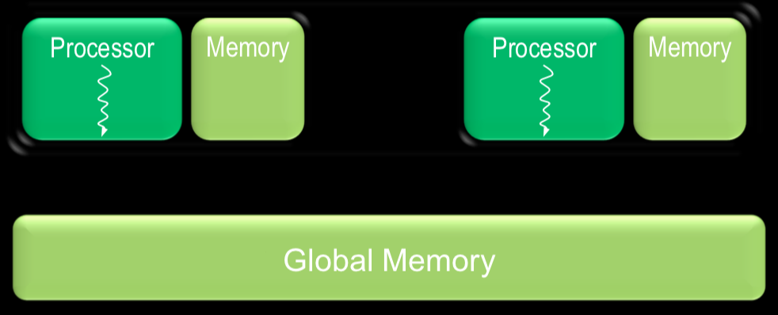
Why GPU (CUDA)?
CUDA vs OpenMP vs MPI
硬件结构
每个处理器运行一个线程
每个处理器有易于访问的片上存储（on-chip memory）
所有处理器共享全局存储器
图片来自NVIDIA

Slide 50
Why GPU (CUDA)?
CUDA vs OpenMP vs MPI
MPI（Message Passing Interface）
跨平台
基于信息传递
常用于计算机集群

Slide 51
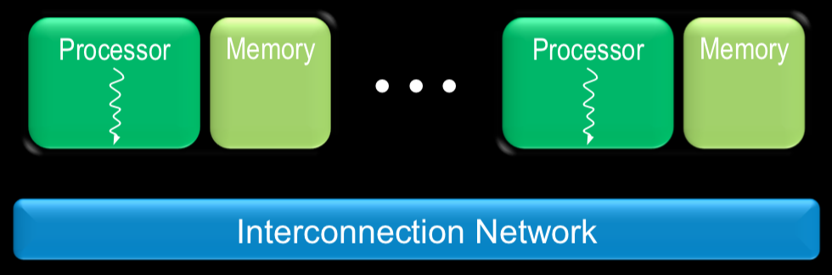
Why GPU (CUDA)?
CUDA vs OpenMP vs MPI
硬件结构
多个处理器之间通过网络发送消息交互
图片来自NVIDIA

Slide 52

Why GPU (CUDA)?
CUDA vs OpenMP vs MPI
CUDA
创建线程开销低
可创建大量线程
控制流简单
OpenMP
创建线程开销高
线程数目有限
线程相互间可以完全独立
控制流复杂
MPI
进程相互间可以完全独立
通信成本高
价格昂贵

Slide 53
Why GPU (CUDA)?
CUDA vs OpenCL
OpenCL: 跨平台的开放标准
生态环境：
CUDA：用户友好、应用广泛（目前NVIDIA投入更大）
OpenCL：使用稍显复杂、目前应用范围较窄
支持硬件：
CUDA：NVIDIA显卡
硬件针对性更强、效率更高、对学习多核编程更有利
OpenCL: AMD、NVIDIA、Intel、ARM等硬件
支持硬件更多、效率因硬件而异、优化因硬件而异
Notes:
Open Computing Language

Slide 54
Why GPU (CUDA)?
CUDA vs OpenCL
OpenCL: 跨平台的开放标准
生态环境：
CUDA：用户友好、应用广泛（目前NVIDIA投入更大）
OpenCL：使用稍显复杂、目前应用范围较窄
支持硬件：
CUDA：NVIDIA显卡
硬件针对性更强、效率更高、对学习多核编程更有利
OpenCL: AMD、NVIDIA、Intel、ARM等硬件
支持硬件更多、效率因硬件而异、优化因硬件而异
“People who are really serious about software should make their own hardware.”
-图灵奖得主Alan Kay

Slide 55
课程概要
History of GPU
Why GPU (CUDA)？
CUDA加速效果
安装与项目创建

Slide 56
CUDA 加速效果
理论效果 – Amdahl’s Law
程序效率受限于其可并行的比例
加速比（s）
可并行的比例（p）
Notes:
Speedup = T_s / T_p = T_s / (pT_s / #threads + (1-p)T_s), as #thread→infty, Speedup = T_s / (1-p)T_s = 1/ (1-p)

Slide 57
CUDA 加速效果
理论效果 – Amdahl’s Law
程序效率受限于其可并行的比例及可供使用的核数
加速比（s）
核数（n）

Slide 58
CUDA 加速效果
案例分析-矩阵乘法
对C中所有元素，计算
共有 次向量乘法（内积）
每次向量乘法为 次浮点数乘法与 次浮点数加法

Slide 59
CUDA 加速效果
案例分析-矩阵乘法
策略1：
创建 个线程，每个计算一个向量内积
当 大于CUDA计算核心数目时，GPU保持满载

Slide 60
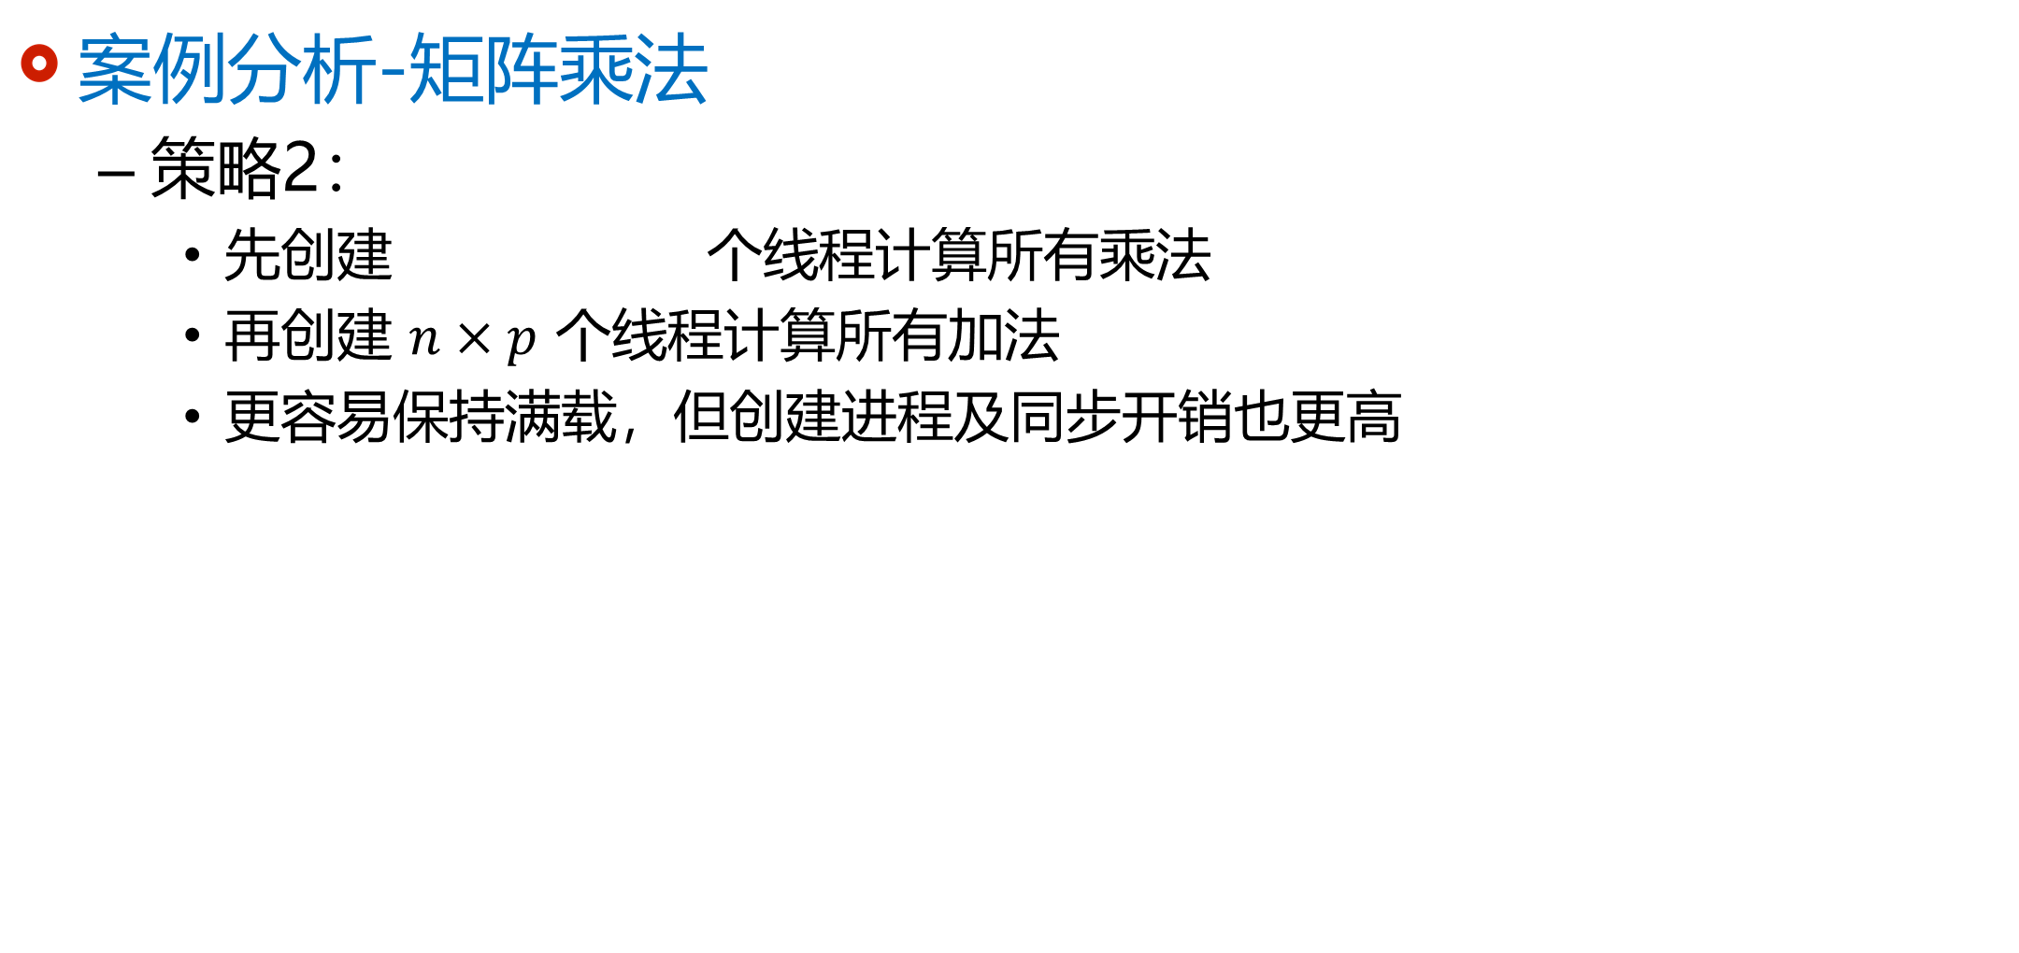
CUDA 加速效果
案例分析-矩阵乘法
策略2：
先创建 个线程计算所有乘法
再创建 $n×p$ 个线程计算所有加法
更容易保持满载，但创建进程及同步开销也更高

Slide 61
CUDA 加速效果
CUDA Zone Showcase
Speedup: 48x
Speedup: 44x
Speedup: 45x
Speedup: 90x

Slide 62
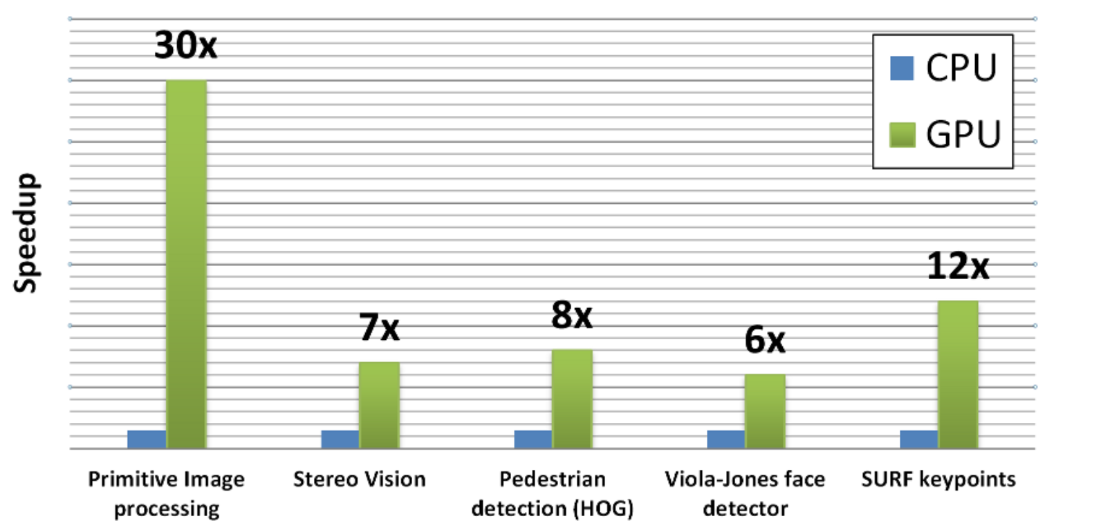
CUDA 加速效果
OpenCV
跨平台计算机视觉库
图片来自OpenCV.org
Tesla C2050 (448 cores) versus Core i5-760 2.8Ghz

Slide 63
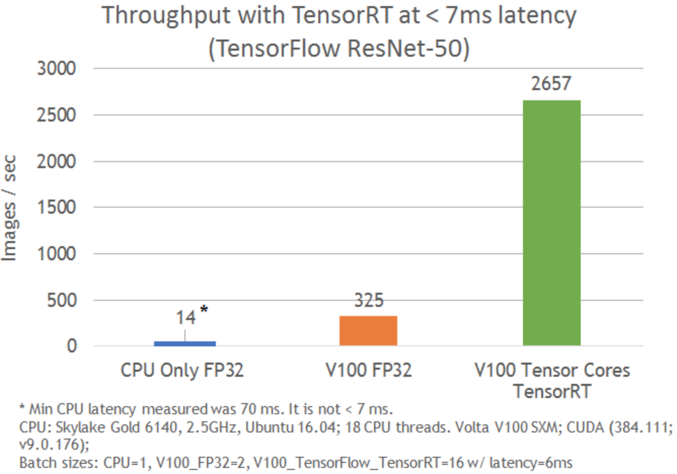
CUDA 加速效果
TensorFlow
深度学习
图片来自Laurence Moroney

Slide 64
CUDA 加速效果
选择你的硬件
显存，半精度/双精度运算能力
GPU | FP64 | FP16 | Memory
GeForce GTX 1080 Ti | up to 0.355 TFLOPS | less than 0.177 TFLOPS | 11GB
GeForce Titan Xp | up to 0.380 TFLOPS | less than 0.190 TFLOPS | 12GB
GeForce Titan V | up to 6.875 TFLOPS | ~27.5 TFLOPS | 12GB
GeForce RTX 2080 Ti | estimated ~0.44 TFLOPS | 28.5 TFLOPS | 11GB
Titan RTX | estimated ~0.51 TFLOPS | up to 32.6 TFLOPS | 24GB
Tesla K80 | 1.87+ TFLOPS | N/A | 24GB
Tesla P100 | 4.7 ~ 5.3 TFLOPS | 18.7 ~ 21.2 TFLOPS | 12GB or 16GB
Quadro GP100 | 5.2 TFLOPS | 20.7 TFLOPS | 16GB
Tesla V100 | 7 ~ 7.8 TFLOPS | 28 ~31.4 TFLOPS | 16GB or 32GB
Quadro GV100 | 7.4 TFLOPS | 29.6 TFLOPS | 32GB
Quadro RTX 6000 and 8000 | ~ 0.5 TFLOPS | 32.6 TFLOPS | 24/48GB
Tesla T4 | estimated ~0.25 TFLOPS | 16.2 TFLOPS | 16GB

Slide 65
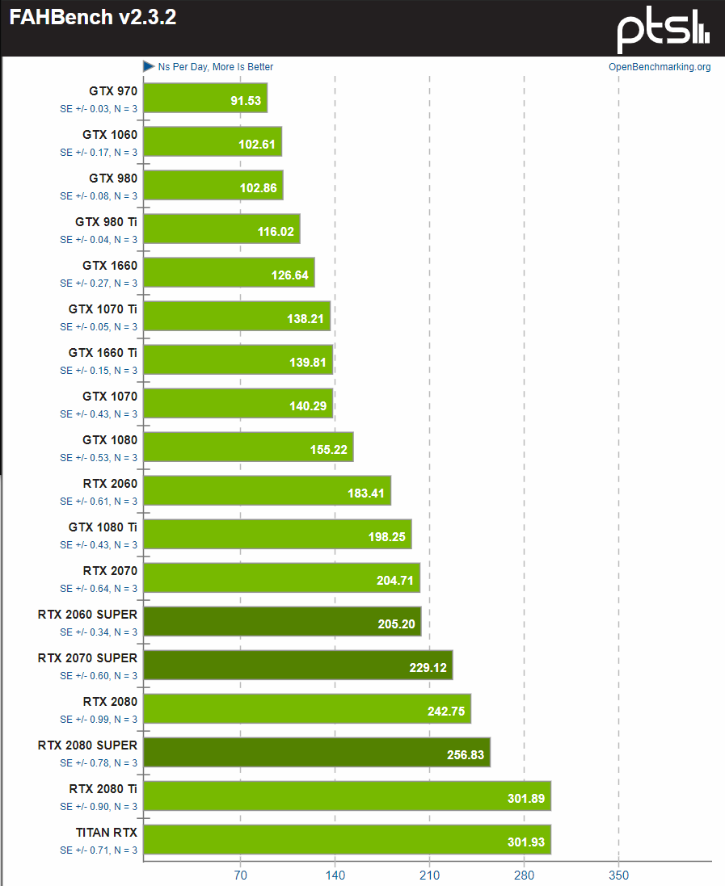
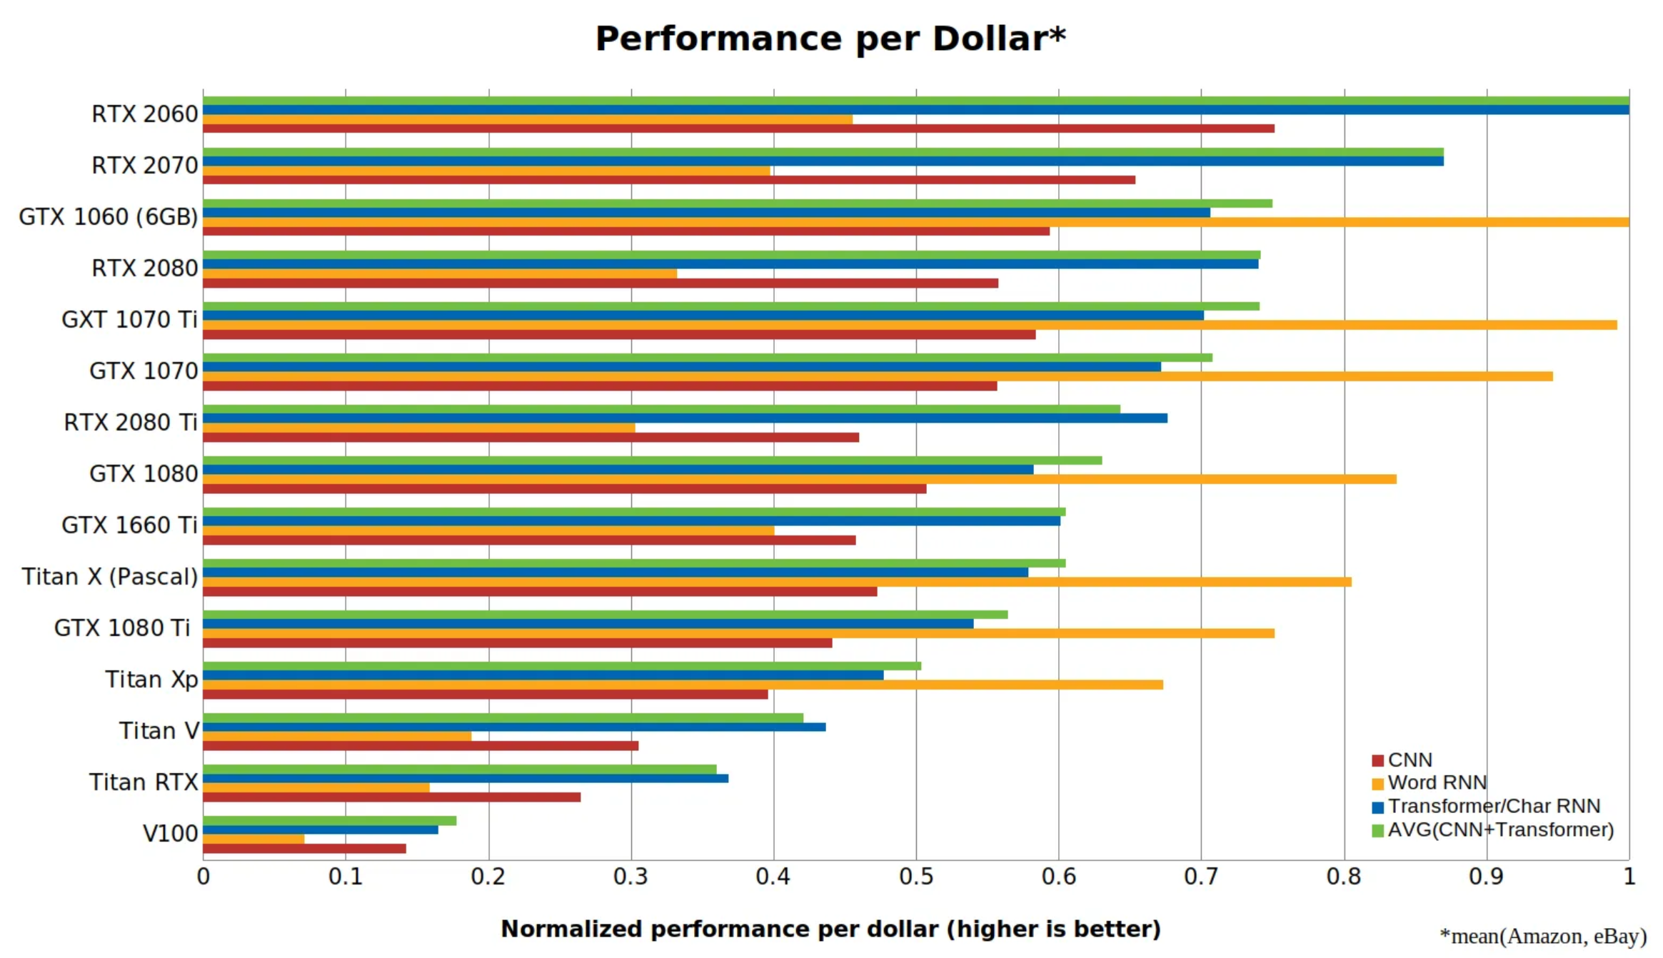
CUDA 加速效果
Performance per watt
选择你的硬件
性价比
图片来自Phoronix.com
图片来自Tim Dettmers

Slide 66
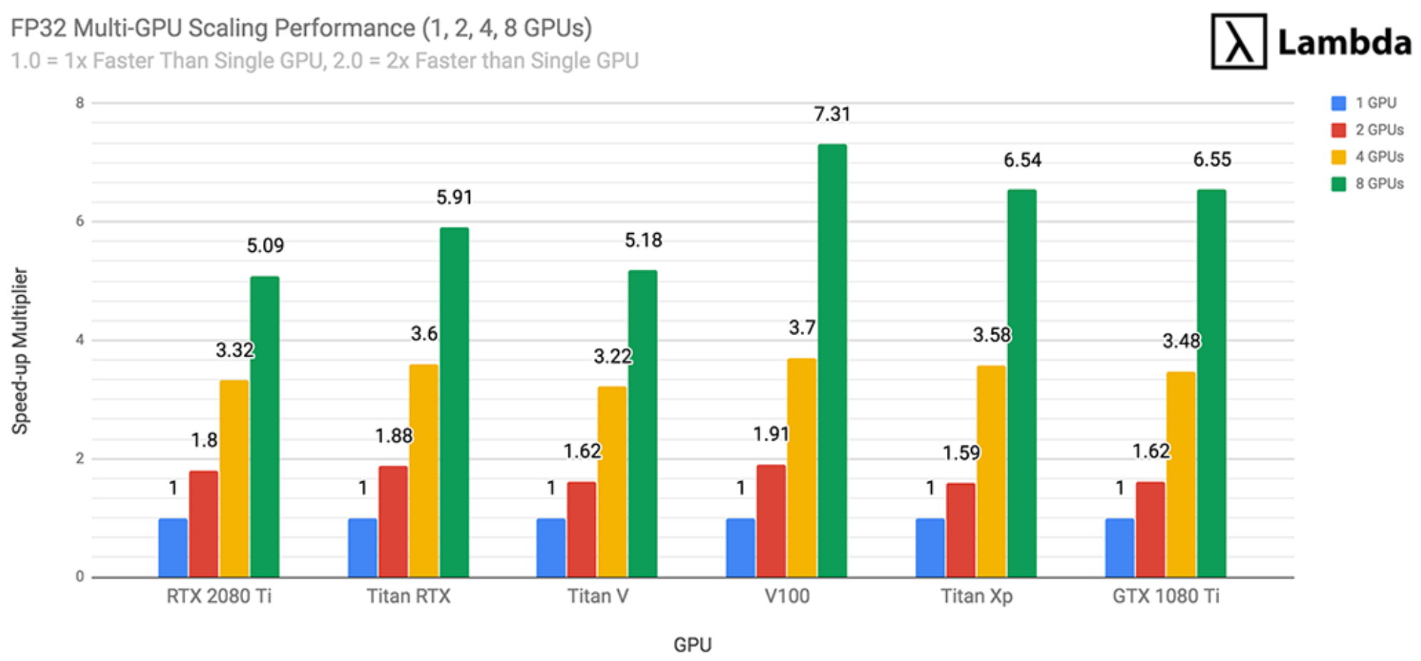
CUDA 加速效果
选择你的硬件
多GPU并行能力
图片来自LambdaLabs

Slide 67
课程概要
History of GPU
Why GPU (CUDA)？
CUDA加速效果
安装与项目创建

Slide 68
安装
下载CUDA Toolkit
下载地址： http://developer.nvidia.com/cuda-downloads
Toolkit
nvcc 编译器
visual profiler
visual studio integration (windows)
Samples
基本功能：device query、band width query等
线性系统：QR factorization, LU decomposition等
图算法：最短路径、PageRank等
模拟：粒子系统、ray tracing等
显卡驱动

Slide 69
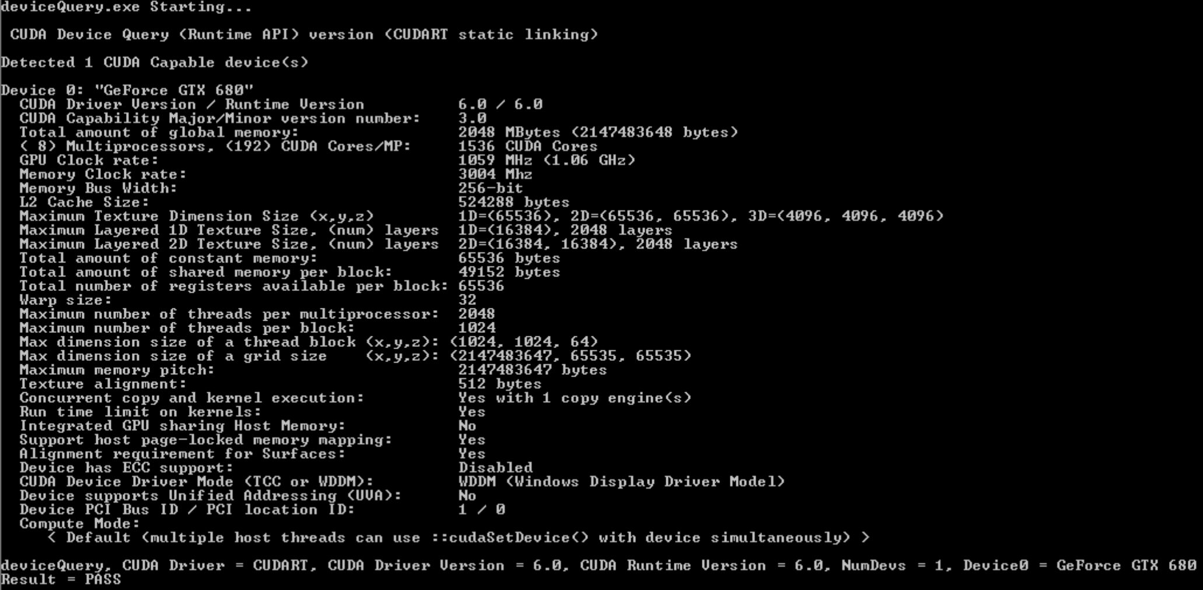
安装
安装
参照说明文档
https://docs.nvidia.com/cuda/cuda-installation-guide-microsoft-windows/index.html
https://docs.nvidia.com/cuda/cuda-installation-guide-mac-os-x/index.html
https://docs.nvidia.com/cuda/cuda-installation-guide-linux/index.html
安装成功后应该能通过
deviceQuery查看支持CUDA的硬件状态

Slide 70
创建项目
简单程序
nvcc直接编译即可
与gcc/g++类似
CMake
跨平台自动化建构系统
Notes:
there are CUDA APIs for C, C++, Fortran, Python, and Java. We’ll be using CUDA C.
the CUDA C compiler can compile both C and C++ programs, and it can do this because it is a modified C++ compiler.
CUDA is not just a library that can be linked in to an ordinary C program: CUDA requires a special compiler. For example, an ordinary C compiler (such as gcc) generates a machine language executable for a single CPU (e.g., an x86 processor), but the CUDA compiler must generate machine language for two different processors: the host processor and the device processor.

Slide 71
创建项目
CMake
通过CMakeLists.txt 指明源文件、依赖关系、目标文件
例子：
# 从helloworld.cu构建helloworld项目
# 检查cmake版本及自动寻找CUDA库路径
cmake_minimum_required(VERSION 2.8)
find_package(CUDA QUIET REQUIRED)
# 指明二进制可执行文件名称及源文件名称
cuda_add_executable(
helloworld
src/helloworld.cu)

Slide 72
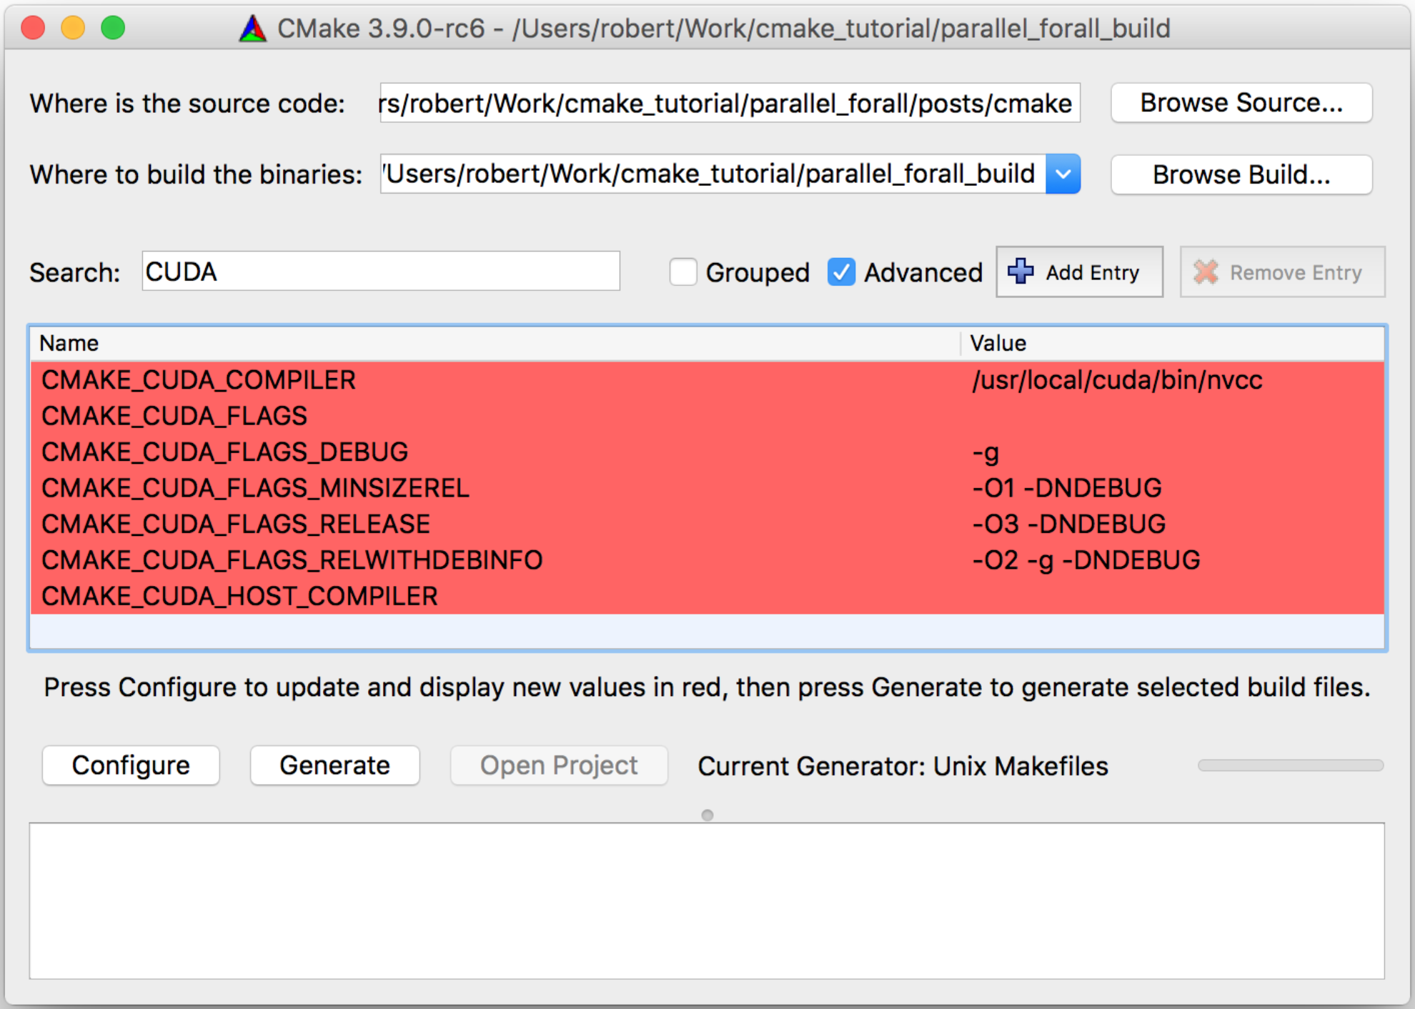
创建项目
CMake
使用命令行或GUI创建项目文件

Slide 73
第一个程序
查询支持CUDA的硬件
源码
输出
int nDevices;
cudaGetDeviceCount(&nDevices);
for (int i = 0; i < nDevices; i++) {
cudaDeviceProp prop;
cudaGetDeviceProperties(&prop, i);
printf(" Device Number: %d\n", i);
printf(" Device name: %s\n", prop.name);
printf(" Memory Clock Rate (KHz): %d\n", prop.memoryClockRate);
printf(" Memory Bus Width (bits): %d\n", prop.memoryBusWidth);
printf(" Peak Memory Bandwidth (GB/s): %f\n\n",
2.0*prop.memoryClockRate*(prop.memoryBusWidth/8)/1.0e6);
}
Device Number: 0
Device name: Tesla C2050
Memory Clock Rate (KHz): 1500000
Memory Bus Width (bits): 384
Peak Memory Bandwidth (GB/s): 144.00

Slide 74

Questions?

